Slide 1
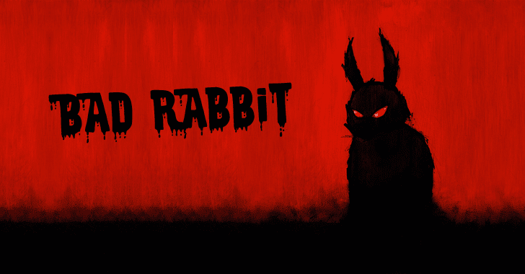

BluesClues Team

Slide 2
What is Bad Rabbit?
What vulnerabilities are exploited?
Use of Ransomware which is a type of malware designed to hijack computers so hackers can force victims to pay a ransom to regain access.
Victims download a fake Adobe Flash installer from infected websites and manually launch the .exe file, thus infecting themselves.
Certain ports in Microsoft Windows Server are vulnerable and allow for execution of these files
Antivirus outdated
User behaviour
Notes:
What it is? Use of ransomware to extort cash. Victims download a fake Adobe Flash installer from infected websites and manually launch the .exe file, thus infecting themselves.The user receives a message that states: "Oops! Your files have been encrypted. If you see this text, your files are no longer accessible." The malware is locking users out and demanding money cash.
Vulnerability: User behaviour creates opportunities for attackers.
Windows Defender Antivirus detects and removes this threat with protection update 1.255.29.0 and higher.

Slide 3
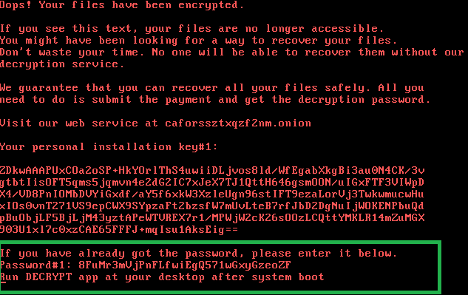
How Bad Rabbit Works
The downloaded file name install_flashplayer.exe must be manually launched by the victim
The victim’s files and disk become encrypted
The ransomware installs a modified bootloader and prevents the normal boot-up process of the infected machine
After the system restarts, a ransom note is displayed demanding 0.05 bitcoin (approx. $280 at time of attack)

Slide 4
Summary of Impact
The attackers behind Bad Rabbit set up their infection network on hacked sites since July of 2017
First started infecting systems on the morning of October 24, 2017.
Roughly 200 infected targets according to KSN statistics
Bad Rabbit mainly targeted media organizations and infrastructure
Attacks lasted until midday with the C&C server for Bad Rabbit shut down in the evening.
Targets included:
Russia 65%
Ukraine 12.2%
Bulgaria 10.2%
Turkey 6.4%
Japan 3.8%
Other 2.4%.
Notes:
KSN - Kaspersky Security Network
https://securelist.com/bad-rabbit-ransomware/82851/

Slide 5

What steps have or can be taken to mitigate damage?
Kaspersky Lab Identifies exploit as an EternalRomance exploit on Windows Servers
Ranked ‘High’ in severity by the NIST National Vulnerability Database
Mitigation
Disabling SMBv1
Blocking certain communication ports on Server
TCP port 445 (Microsoft DS -file/print sharing)
UDP ports 137-138/TCP 139 (NetBIOS over TCP/IP -Legacy non-Networking system)
Patch or update Microsoft Server
Or… you could just pay the data kidnappers.

Slide 6
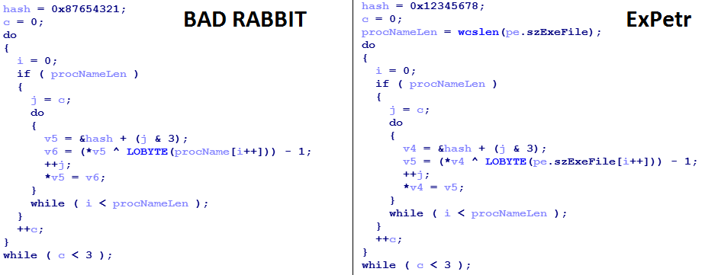
Bad Rabbit Findings and Security Reports
Bad Rabbit doesn’t delete shadow copies so it can be possible to recover original versions of the encrypted files.
The Bad Rabbit hashing algorithm is very similar to the ExPetr ransomware hashing algorithm
Files are encrypted using two algorithms that are typically used for ransomware.
AES-128-CBC
RSA-2048
Notes:
https://www.allot.com/wp-content/uploads/Threat-Bulletin_BadRabbit_10-2017.pdf
https://securelist.com/bad-rabbit-ransomware/82851/

Slide 7
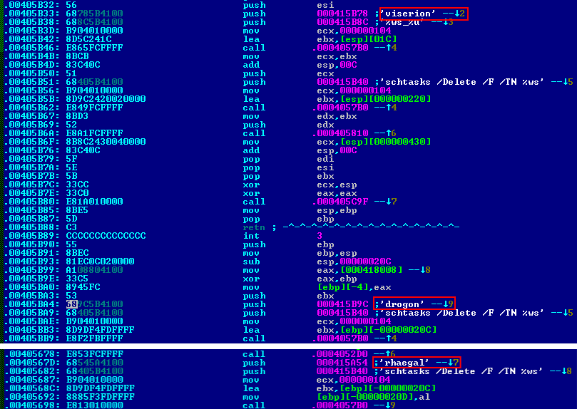
Bad Rabbit Findings and Security Reports (cont.)
Bad Rabbit has the ability to spread itself throughout a network.
Scans the networks for open SMB shares
Utilizes compromised computers to find usernames and passwords using a brute-force technique.
Once a working login is found infpub.dat (BadRabbit) is put into the directory and executed.
Some strings of code found in Bad Rabbit contain the names of Game of Thrones characters.

Slide 8
BadRabbit
Ransom:Win32/Tibbar.A
What is or was the exploit, vulnerability, or threat actor? Rosita
What damage has it done? Angelo
What steps have or can be taken to mitigate the damage? Craig
Security Reports and BadRabbit findings? Joey
Blue Clues Team

